Slide 1
Fastai Lesson 8a
Infrastructure
Broadcasting
Next week:
Sat. 7/13 Lesson 8b
TWiML Fastai Meetup Sat. 06 Jul 2019 Joseph Catanzarite

Slide 2
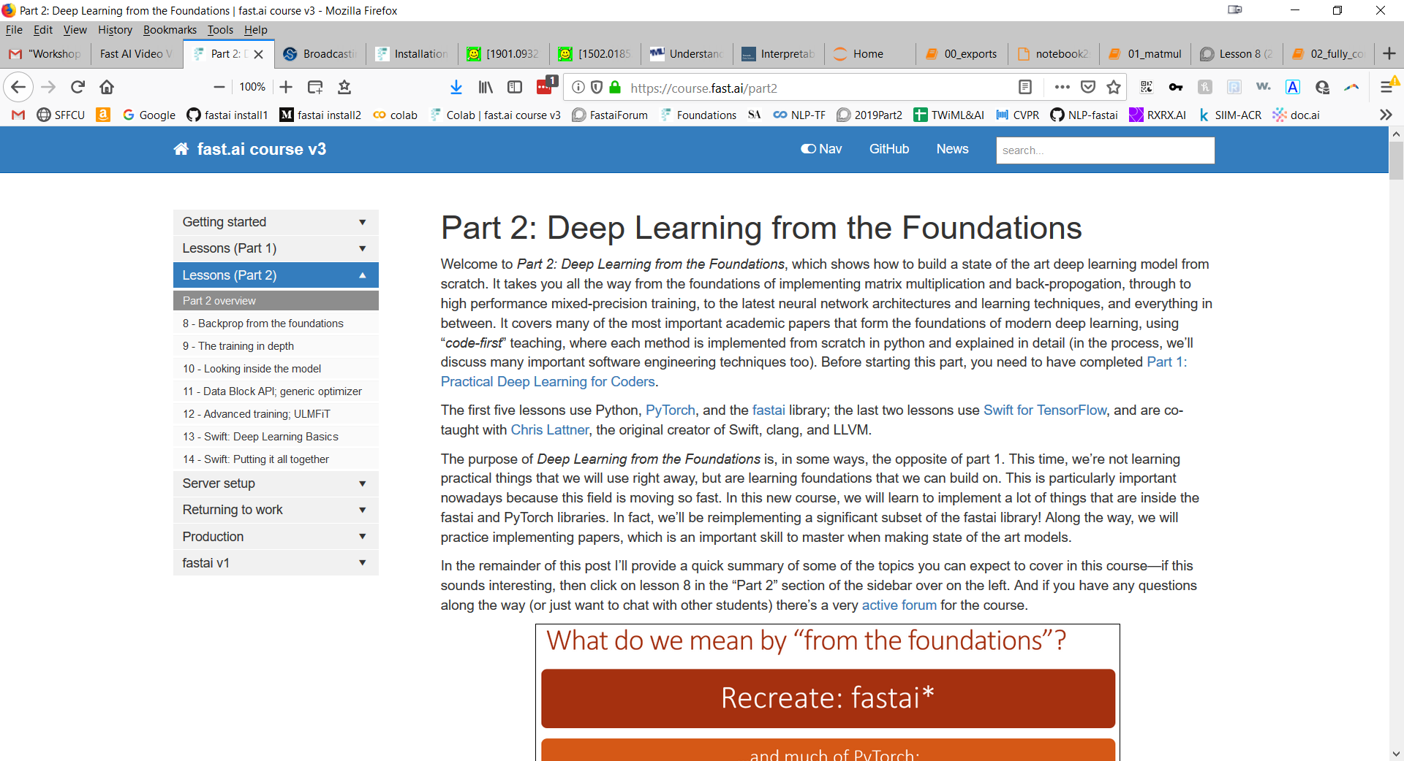
Overview

Slide 3
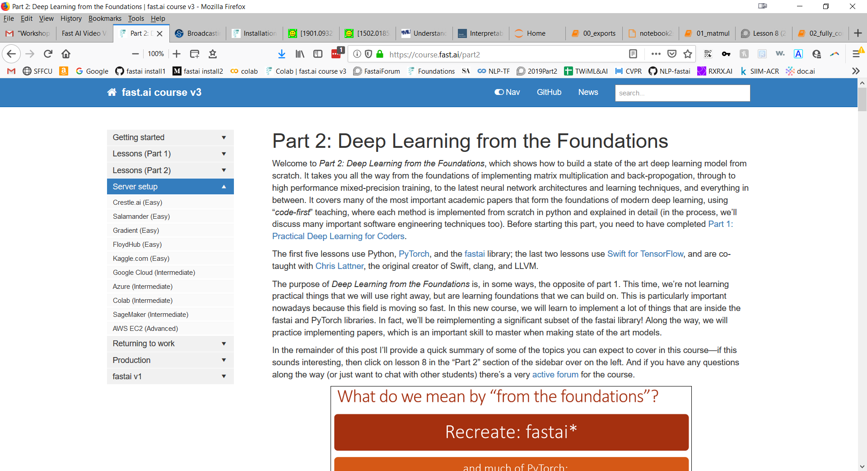
Run the notebooks on the cloud

Slide 4
Or, run the notebooks on your own computer
How to install fastai v1 on Windows 10
Medium article by Pierre Guillouhttps://medium.com/@pierre_guillou/how-to-install-fastai-v1-on-windows-10-ca1bc370dce4
Installation Guide on fastai/README
https://github.com/fastai/fastai/blob/master/README.md#conda-install

Slide 5
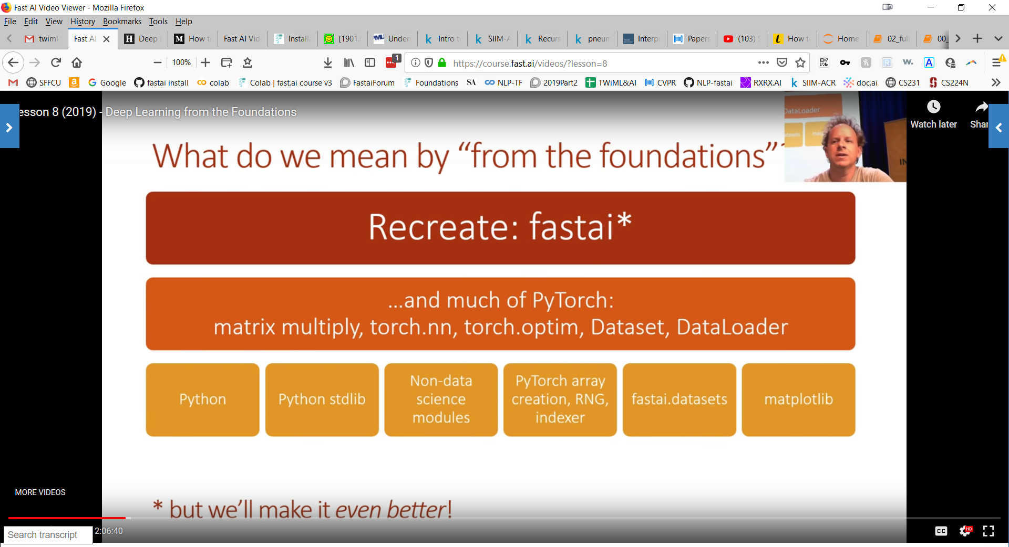

Slide 6
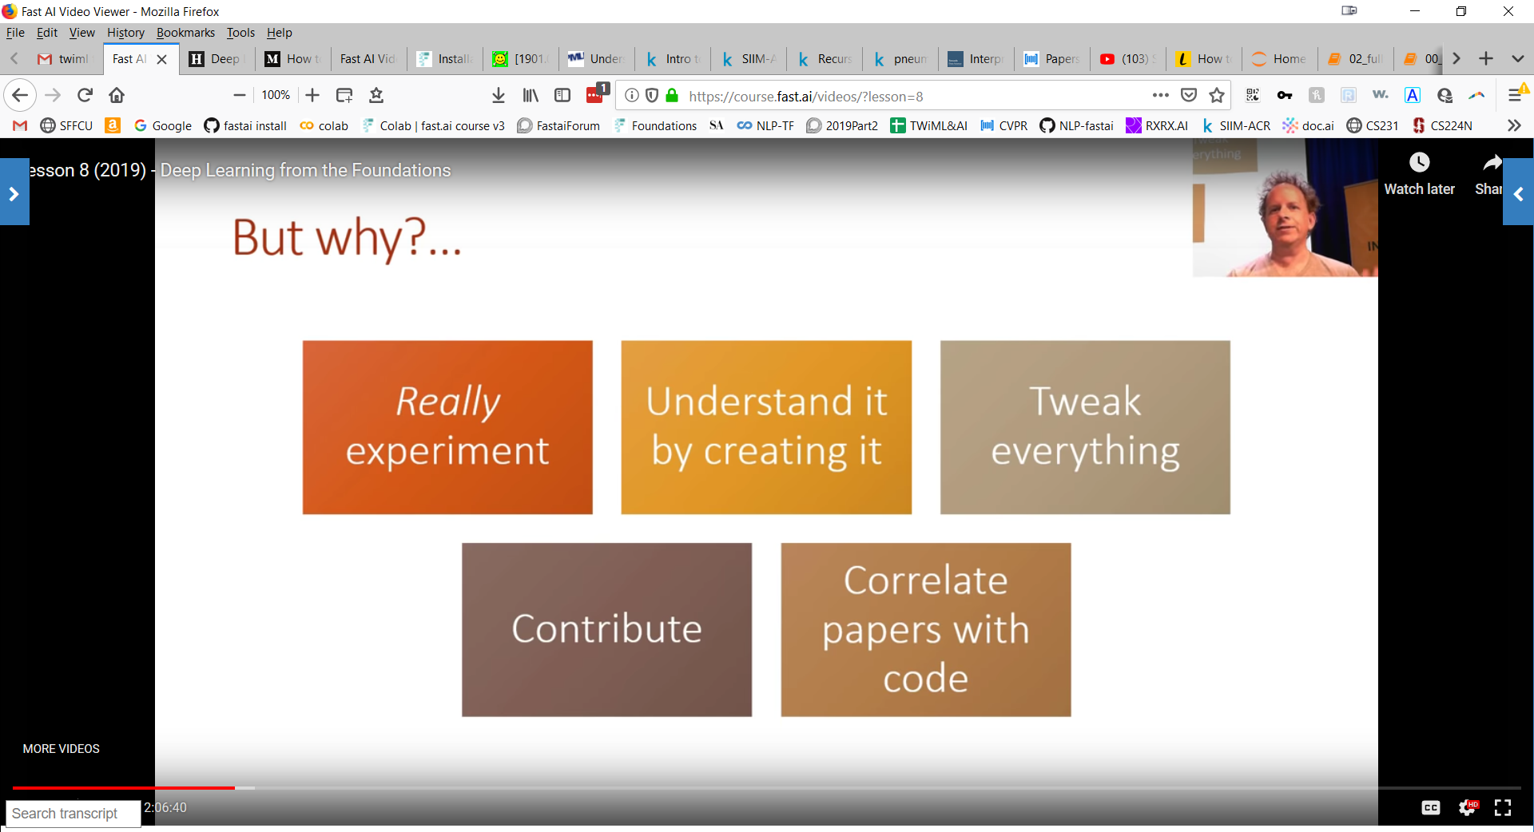

Slide 7
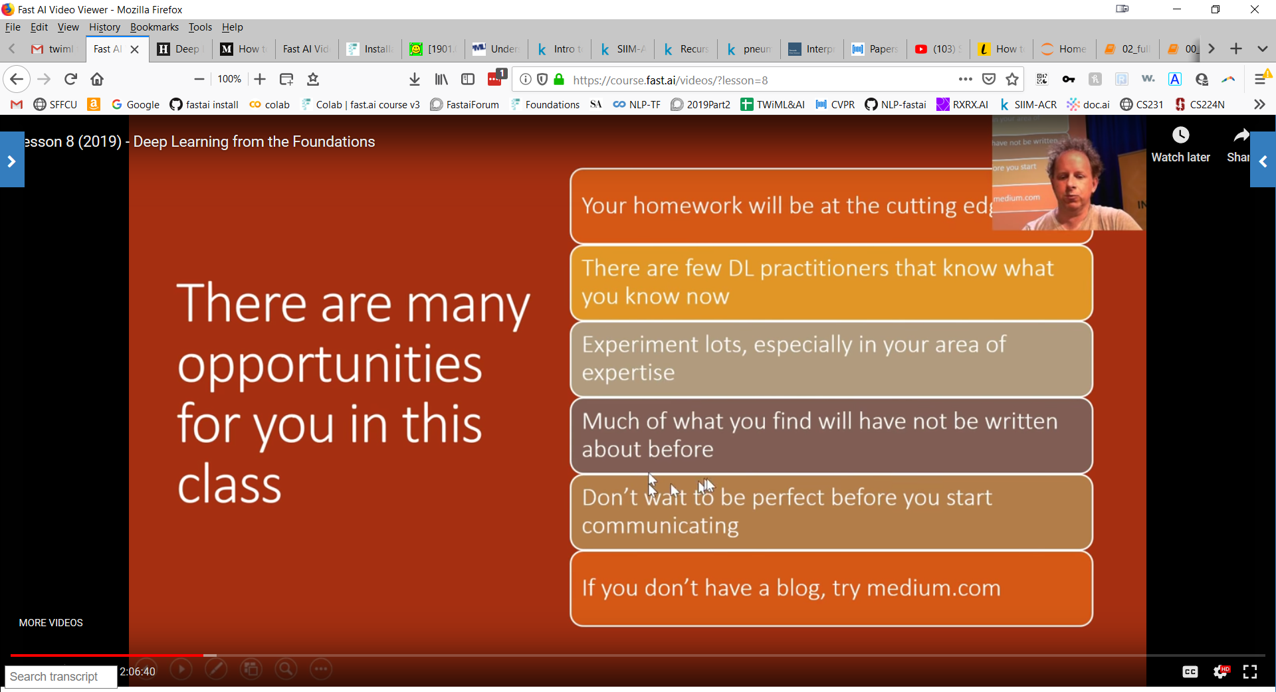

Slide 8
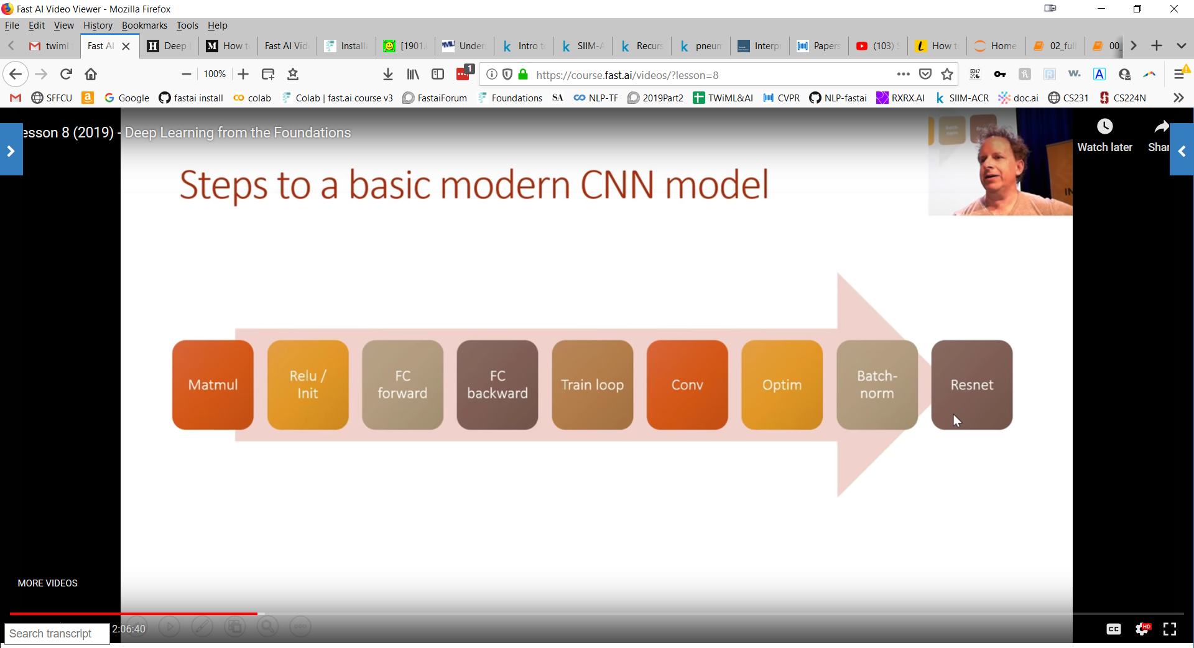
Road map for the first few lessons

Slide 9
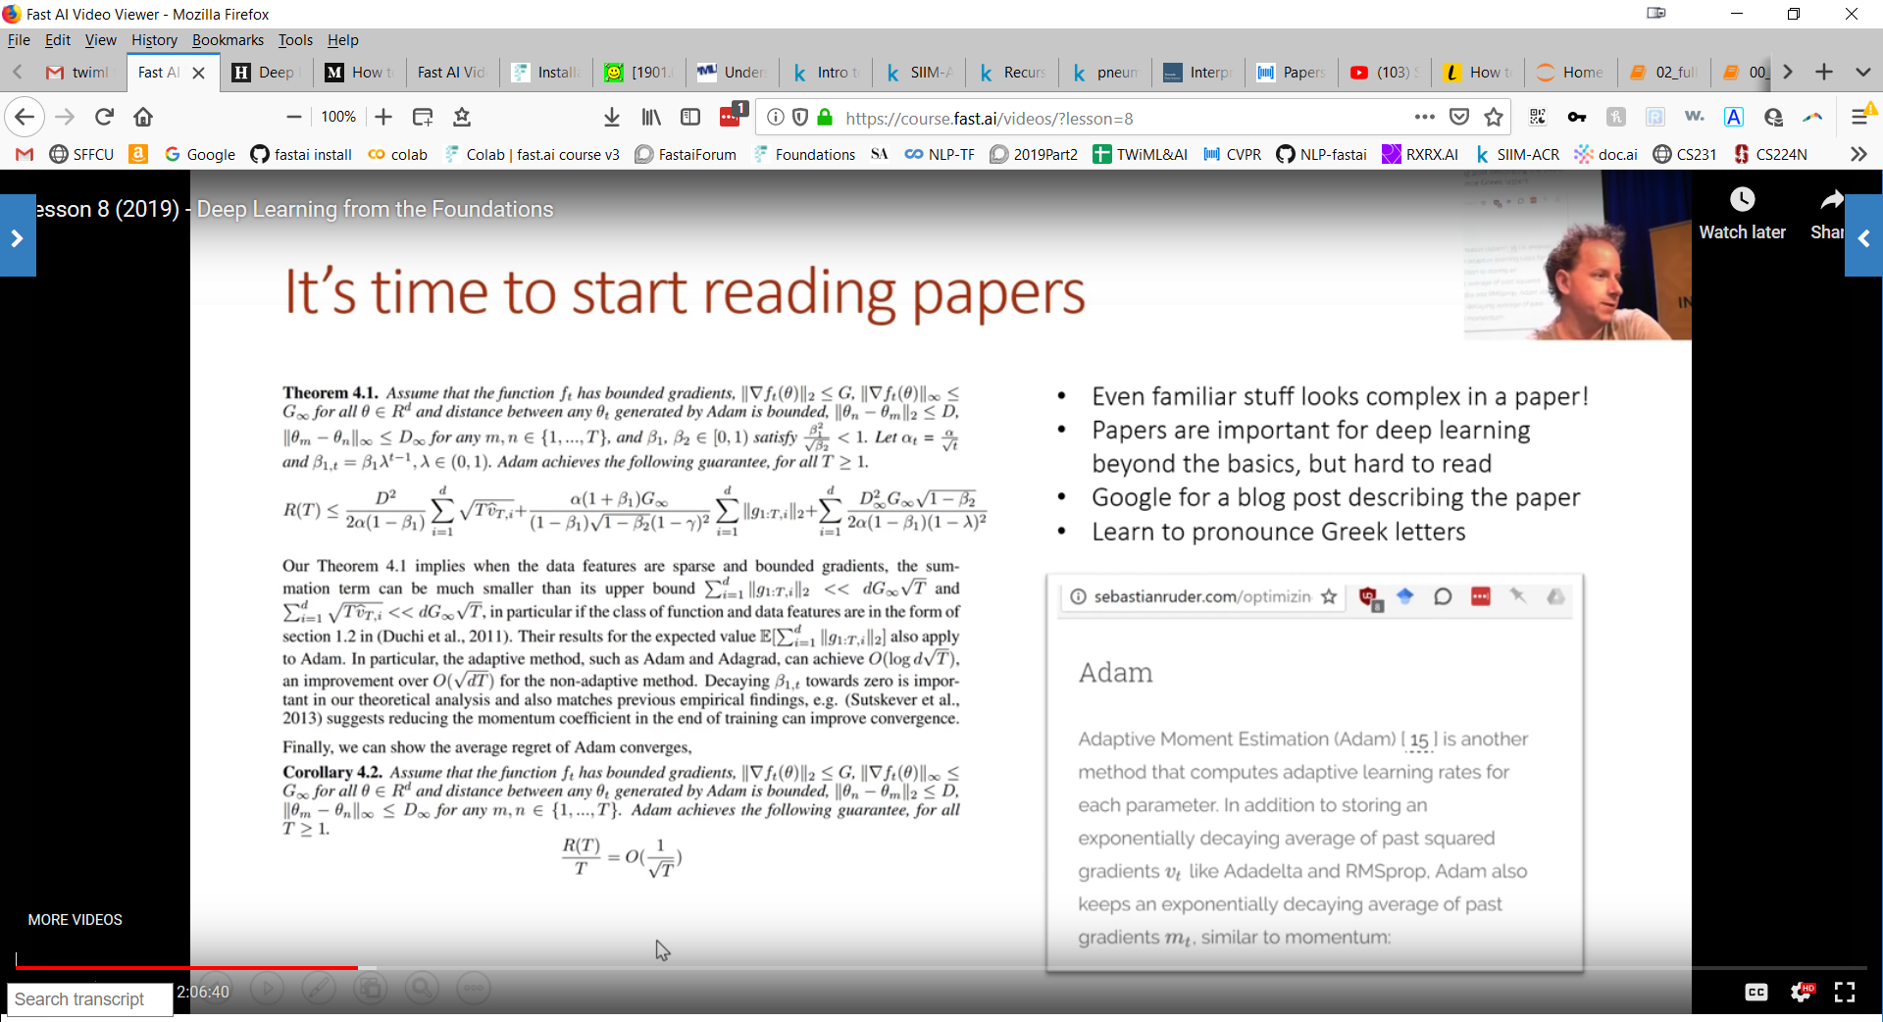
Familiarize with Math symbols and Greek alphabet

Slide 10
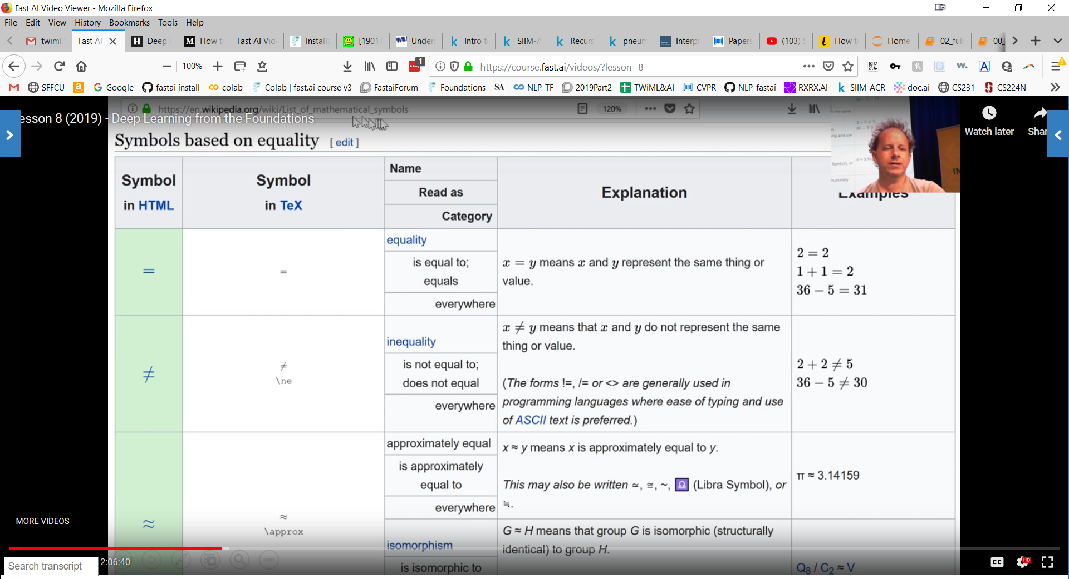
https://en.wikipedia.org/wiki/List_of_mathematical_symbols

Slide 11
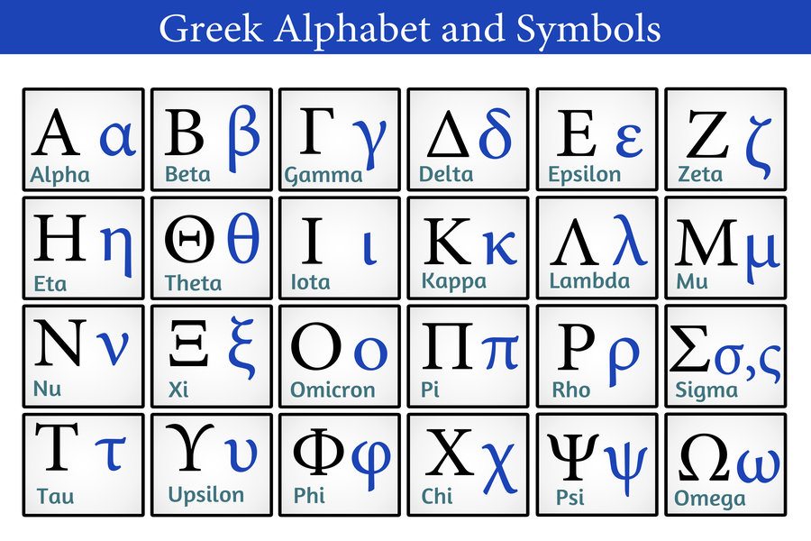

Slide 12
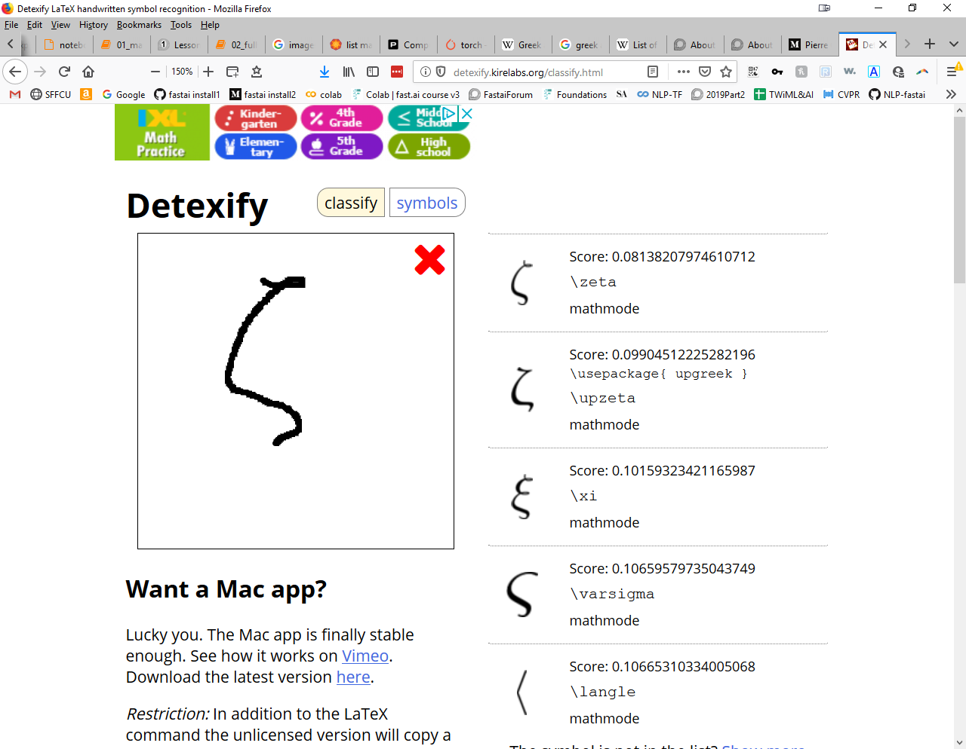
http://detexify.kirelabs.org/classify.html

Slide 13
First notebook 00_exports.ipynb:
!python notebook2script.py 00_exports.ipynb
Converts 00_exports.ipynb to exp\nb_00.py, a python module
Next notebook 01_matmul.ipynb:
from exp.nb_00 import *
Each notebook imports material from the previous notebook, in the form of a file exp\nb_xx.py
Exporting jupyter notebooks as Python modules

Slide 14
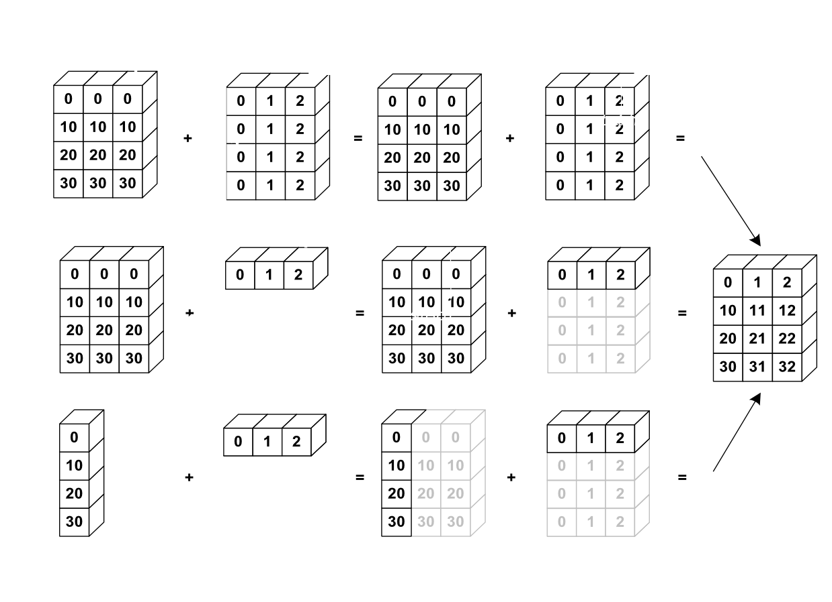
Extends array operation syntax via implicit rules
Broadcasting
https://mathematica.stackexchange.com/questions/99171/how-to-implement-the-general-array-broadcasting-method-from-numpy

Slide 15
Rule 1: If the two arrays differ in their number of dimensions, the shape of the one with fewer dimensions is padded with ones on its leading (left) side.
Rule 2: If the shape of the two arrays does not match in any dimension, the array with shape equal to 1 in that dimension is stretched to match the other shape.
Rule 3: If in any dimension the sizes disagree and neither is equal to 1, an error is raised.
Broadcasting Rules
https://jakevdp.github.io/PythonDataScienceHandbook/02.05-computation-on-arrays-broadcasting.html

Slide 16
00_exports.ipynb and 01_matmul.ipynb
Play with them until you understand as much as you can!
Also, have a look inside
notebook2script.py
to see what it’s doing
Run through the notebooks

Slide 17
Set up your environment to run notebooks!
Study the second half of Lesson 8, on forward and backward propagation
Work through the associated notebook 02_fully_connected.ipynb
Read section 2.2 in the “Delving Deep Into Rectifiers” paper
https://arxiv.org/abs/1502.01852
For next time

